Slide 1

American International University – Bangladesh Faculty Of Science & Technology
COMPUTER ORGANIZATION AND ARCHITECTURE
Section: F
Title: Bits in Motion
An In-Depth Exploration of x86 Assembly SHIFT
Submitted to: SAEEDA SHARMEEN RAHMAN

Slide 2
Our Members
1.Name: Jawad Abdullah
Id: 20-44133-2
2. Name:Tanjil Hasan Sakib
Id: 20-43633-2
3. Name:Aminul Islam Sagor
Id: 20-44105-2
4. Name:Jariatun Islam
Id: 21-44458-1

Slide 3
Table of Contents
Shifting
Shift Left –
SHL
SAL
Shit Right –
SHR
SAR
Problem

Slide 4
Shifting
Shifting refers to the process of moving the bits of a binary number to the left or right.
There are four main types of shifts:
Logical Left Shift (SHL)
Arithmetic Left Shift (SAL)
Logical Right Shift (SHR)
Arithmetic Right Shift (SAR)

Slide 5
Logical Left Shift (SHL)
Operation: Shifts the bits of a binary number to the left and zero is placed in the empty slots.
Instruction: SHL destination, count.
Effect: Multiplies the value in the destination by 2 raised to the power of the count.
Carry Flag: Set to the value of the bit that was shifted out.

Slide 6
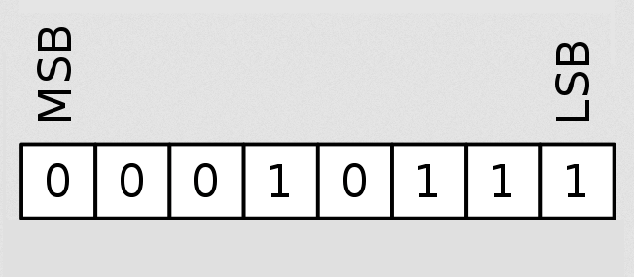
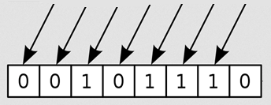
Logical Left Shift (SHL) –Simulation

Slide 7
Arithmetic Left shift (SAL)
Operation: Shifts the bits of a binary number to the left and zero is placed in the empty slots, same as SHL
Instruction: SAL destination, count.
Effect: Same as SHL for unsigned integers.
Carry Flag: Set to the value of the bit that was shifted out from left.

Slide 8
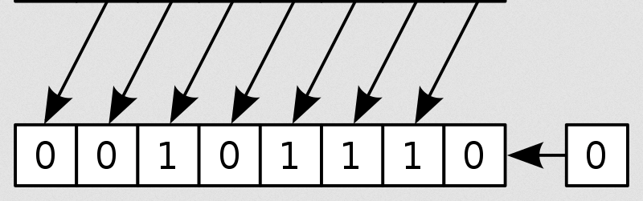
Arithmetic Left shift (SAL) -Simulation

Slide 9
Logical Right shift (SHR)
Operation: Shifts the bits of a binary number to the right.
Instruction: SHR destination, count.
Effect: Divides the value in the destination by 2 raised to the power of the count (for unsigned integers).
Carry Flag: Set to the value of the bit that was shifted out from right.

Slide 10
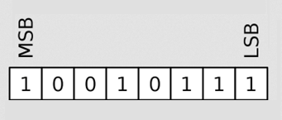
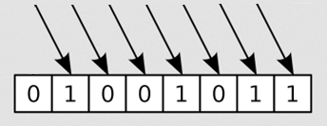
Logical Right shift (SHR) -Simulation

Slide 11
Arithmetic Right Shift (SAR)
Operation: Shifts the bits of a binary number to the right, but used for signed integers.
Instruction: SAR destination, count.
Effect: Divides the value in the destination by 2 raised to the power of the count (for unsigned integers). For signed integers, the sign bit is replicated during the shift.
Carry Flag: Set to the value of the bit that was shifted out from right.

Slide 12
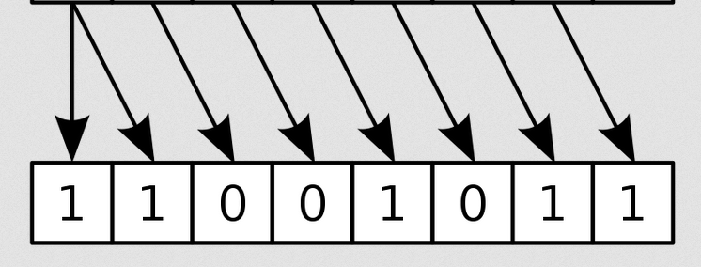
Arithmetic Right Shift (SAR) -Simulation

Slide 13
Problem Statement
Developing a password system in the assembly code program that enables users to encrypt and decrypt their input using shifting. The shifting involves moving each character by a specified number of positions, both to the left for encryption and to the right for decryption.

Slide 14
Problem’s Solution:
.model small .stack 100h .data userM1 db "Enter a number: $" userM3 db "Encryption: $" userM4 db "Decryption: $" .code mov ax, @data mov ds, ax main proc ; Display prompt for user to enter a number mov ah, 09; lea dx, userM1; int 21h; | ; Input a character MOV AH, 1; INT 21H; mov bl, al; ; New line MOV AH, 2; MOV dl, 0Dh; Int 21H; MOV dl, 0Ah; Int 21H; ;encrypt SHL bl, 2 ;

Slide 15
Problem’s Solution:
; Display message MOV AH, 09; lea dx, userM3; int 21h; ; Output of encryption MOV AH, 2; MOV dl, bl; INT 21H; ; New line MOV AH, 2; MOV dl, 0Dh; Int 21H; MOV dl, 0Ah; Int 21H; | ; Display message MOV AH, 09; lea dx, userM4; int 21h; ;decrypt SHR bl,2 ; Shift right by 1 bit ; Output the result MOV AH, 2; MOV dl, bl; INT 21H; ; Exit the program MOV AH, 4CH; INT 21H endp

Slide 16
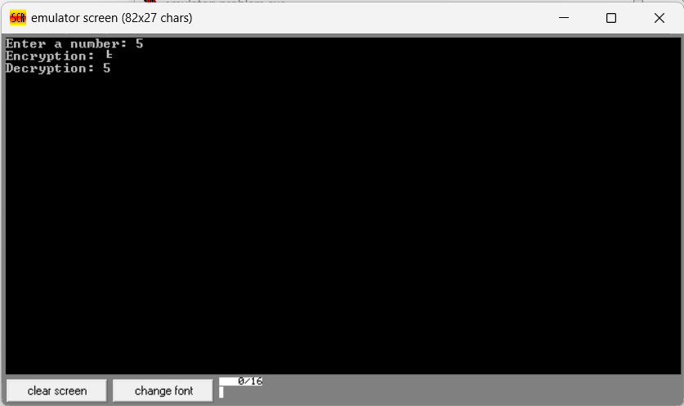
Output :

Slide 17
Thank You We appreciate your attention.

